Slide 1


Investing 101
Presented by Lawrence Delva-Gonzalez
IG Handle: @GQ_Accountant
and @TheNeighborhoodFinanceGuy
www.TheNeighborhoodFinanceGuy.com
Also on
The Financial Griot
Listen Here

Slide 2

TFG Promise and Ongoing Commitment
For more information,
TheNeighborhoodfinanceguy.com
Notes:
Top 10 Questions to Start?

Slide 3
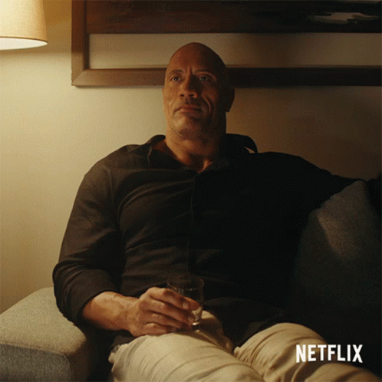
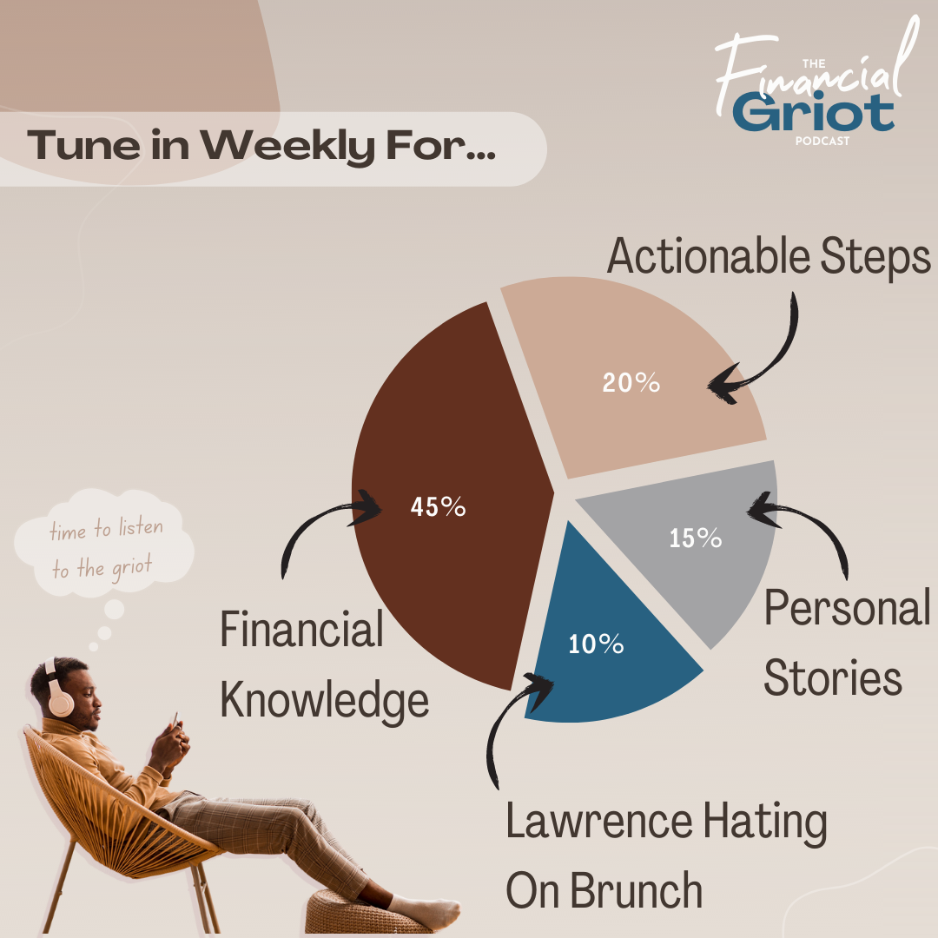
What The Financial Griot Offers?
90% of which is all FREE!
The Financial Griot Podcast
1.5 Episode Weekly on all Platforms
The Neighborhood Finance Guy Website
  Over 500 Blog Posts and Over 75 FREE Resources.

Slide 4
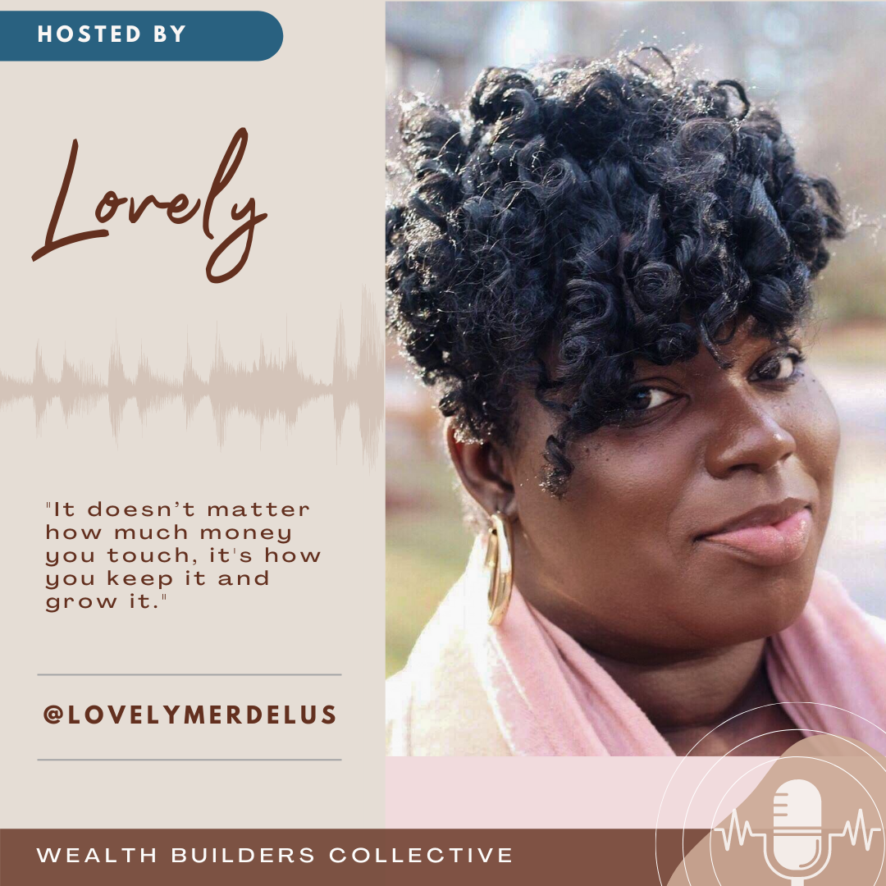
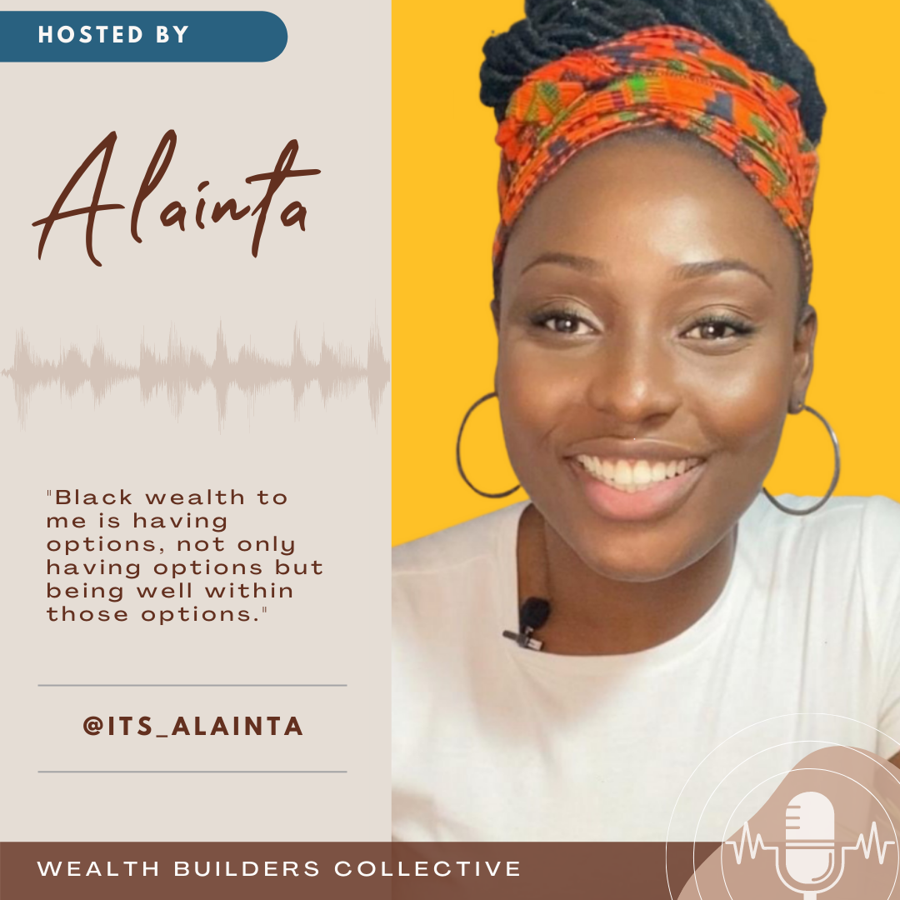
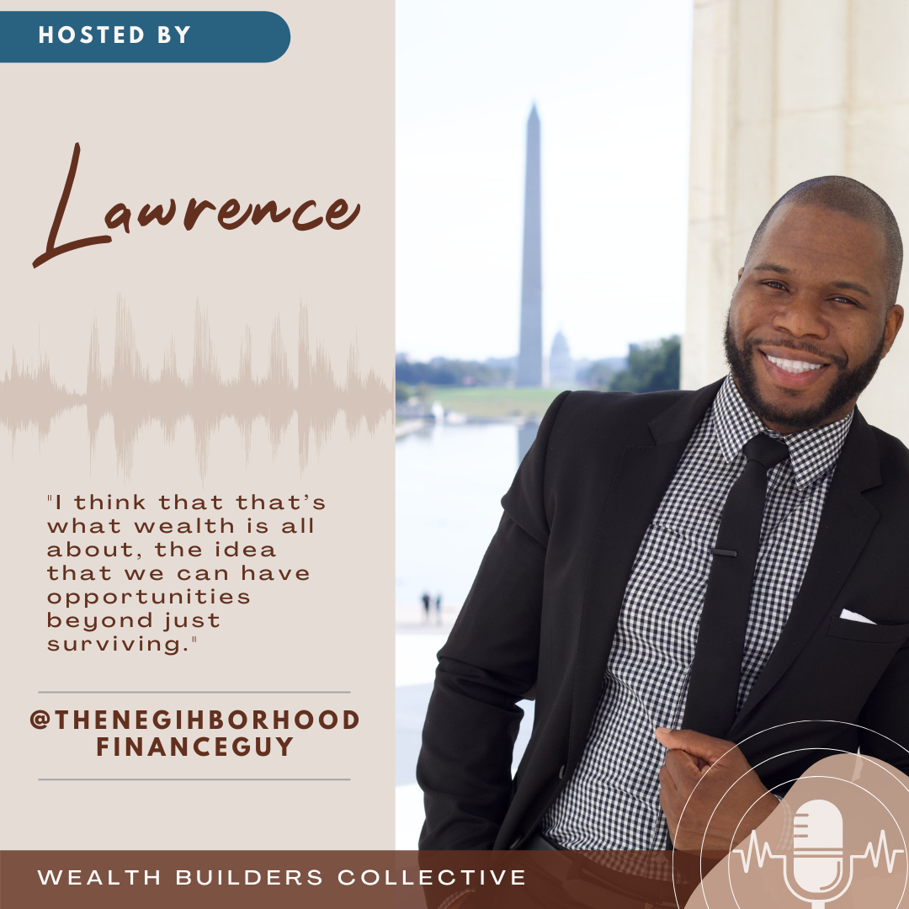
The Financial Griot Team
Because We Can’t Tackle Wealth Building Alone.
Over $4.5M in Assets.
Over 45 years of Experience in the field of Accounting, Taxation, Auditing, Finance, Small Business Incubation, Medical Insurance, Tech, Marketing and Sales.
And, “Way too much of Lawrence hating on Brunch.”

Slide 5

“Having an Investment Plan means that you don’t have to work until you die.”
Notes:
1st Generation
Single Parent Household
Never made more than $30k per year
Raise partial in Haiti and Miami
Joined the Marines on a whim
Attended FSU
Didn’t get my life in order until 10 years ago.

Slide 6



Sometimes the end is better…
Dropped out of the Master’s Program for Accounting/Taxation
  A total $110k in student loans (2012) + $10k Interest Capitalization
$0 in savings, $0 in retirement with Negative $125,000 in Net Worth
  My post failure job was as an Admin. Secretary ($23k/year Pre-Tax)
As of January 2026 - $2M+ in Net Worth with a credit score of 847.
  Additionally, traveled to over 27 Countries, Got Married and Got a Pandemic Puppy, and 2x Homeowner which includes an out of state, new EV car loan, and rental property.
  Currently making about $141k (2025) but Trump say no increase for 2026.
Notes:
So broke that…
When the dentist told me he would have to pull out all my wisdom teeth, I opted for local anesthesia

Slide 7
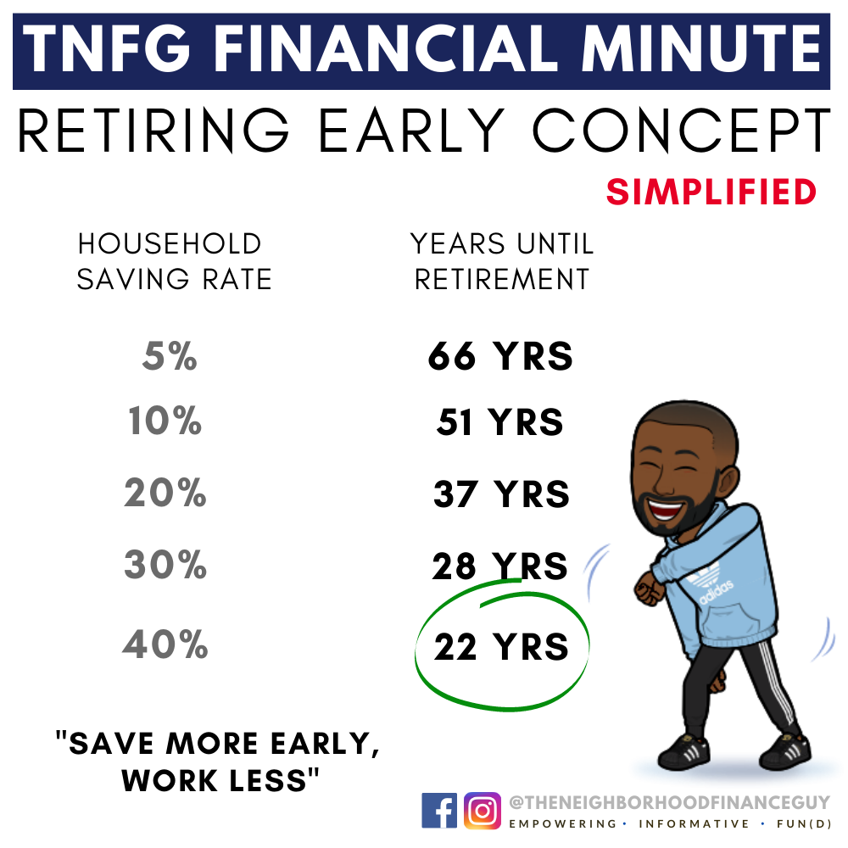
Alright Enough with the Intro!
Why Should We Take Advice from You?
January 2014
Started January 2014 with $500 in a retirement investment account.
August 2025
As of August 25, 2025, my wife and I amassed over $1,245,000 in investments.

Slide 8
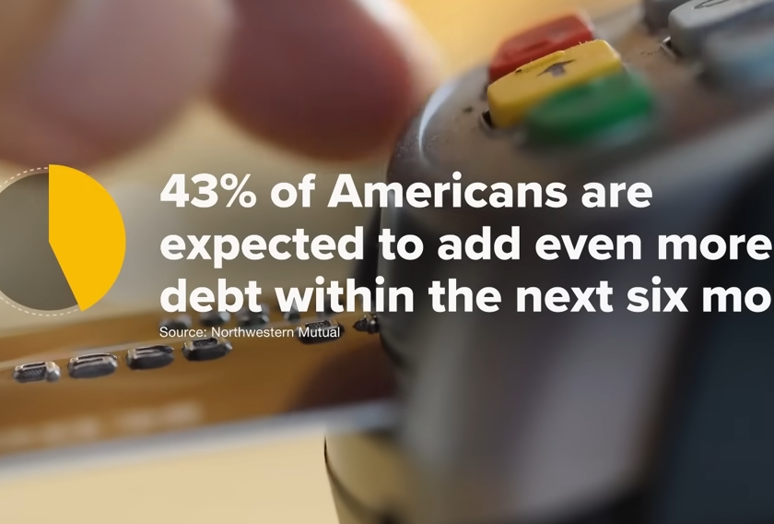
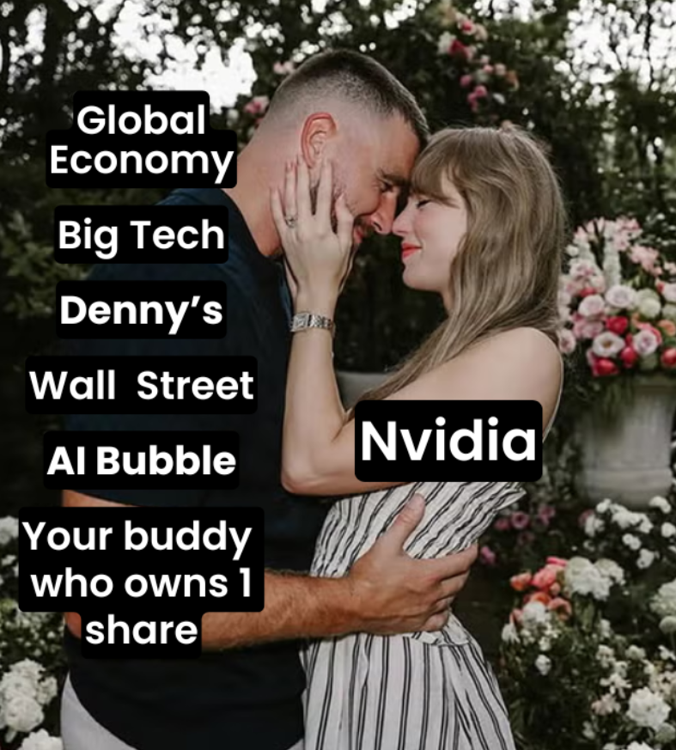


So Instead of Breaking Distractions
Focus Up
Notes:
Turns out it’s not.
The average person making over $100k today is living paycheck to paycheck
Market is slowing down, global economic turmoil
Inflation in the US hit over 9% (high of 40 years), now down to 3% but prices are still high
Housing prices are up and interest rate is up over 5%
Russia and Ukraine
Argentina and 125%
Retirement Crisis
Quiet Quitting
Soft life
Loud Budgeting

Slide 9
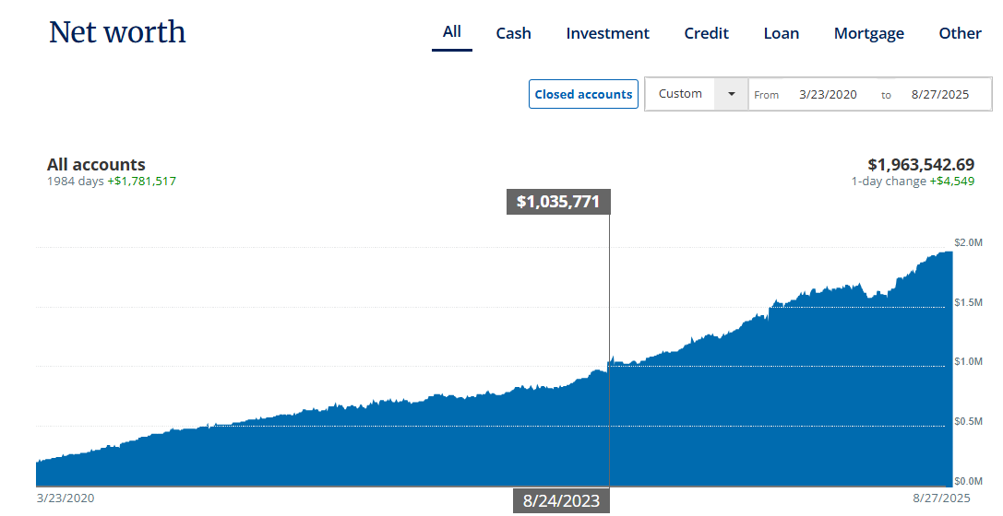
Post Pandemic?
Data Pulled from Personal Capital

Slide 10
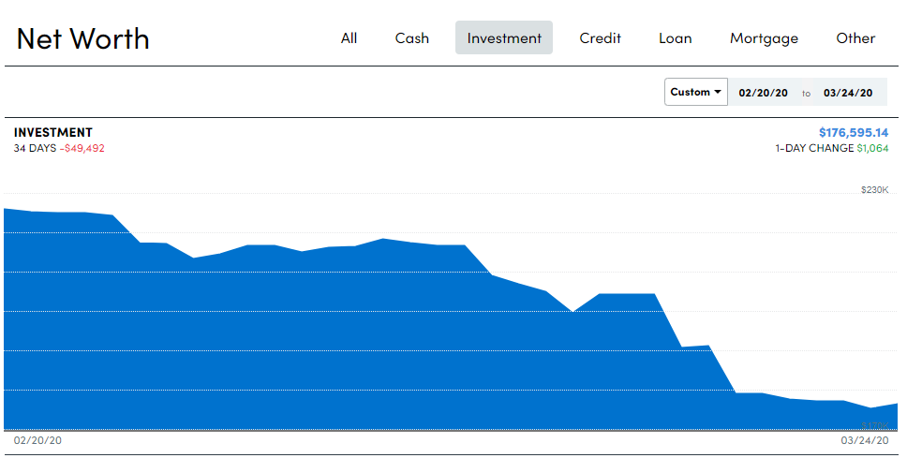
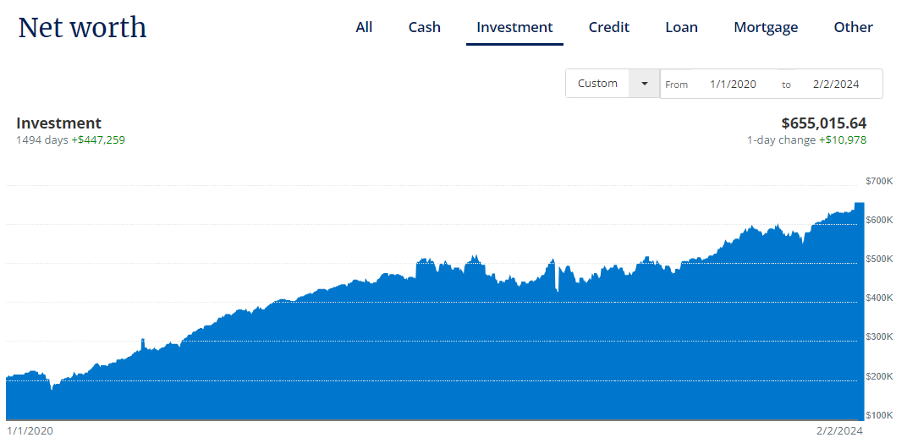
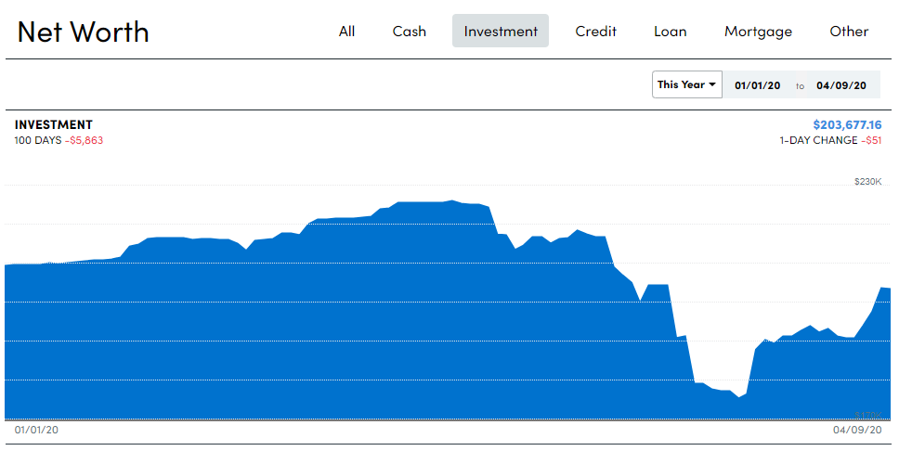
Downturns should be expected
- $50,000
+ $500,000
Notes:
Real portfolio. It will continue to grow and gain exponential momentum toward the future.

Slide 11
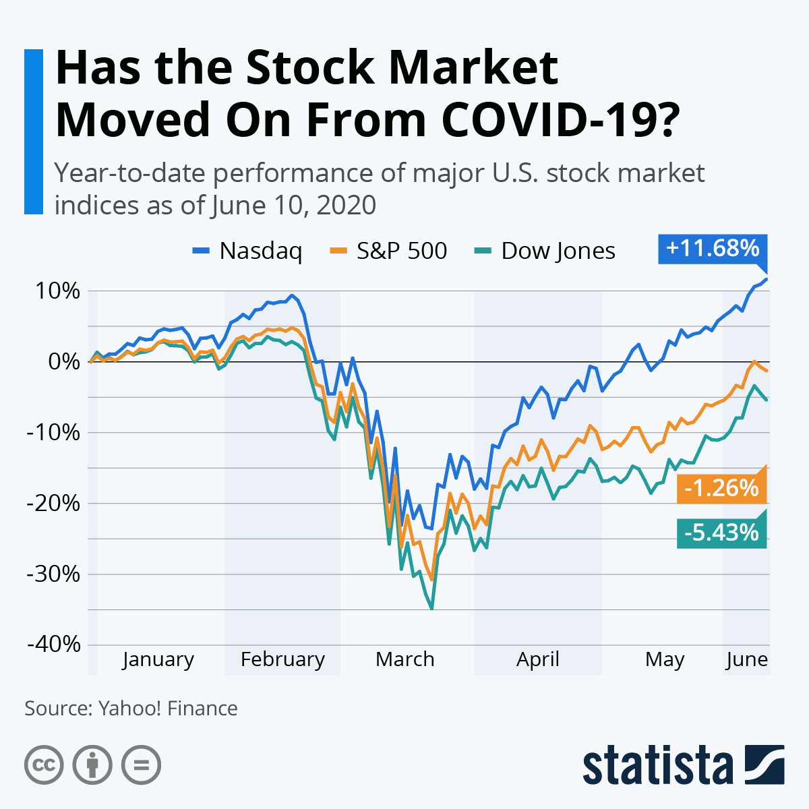
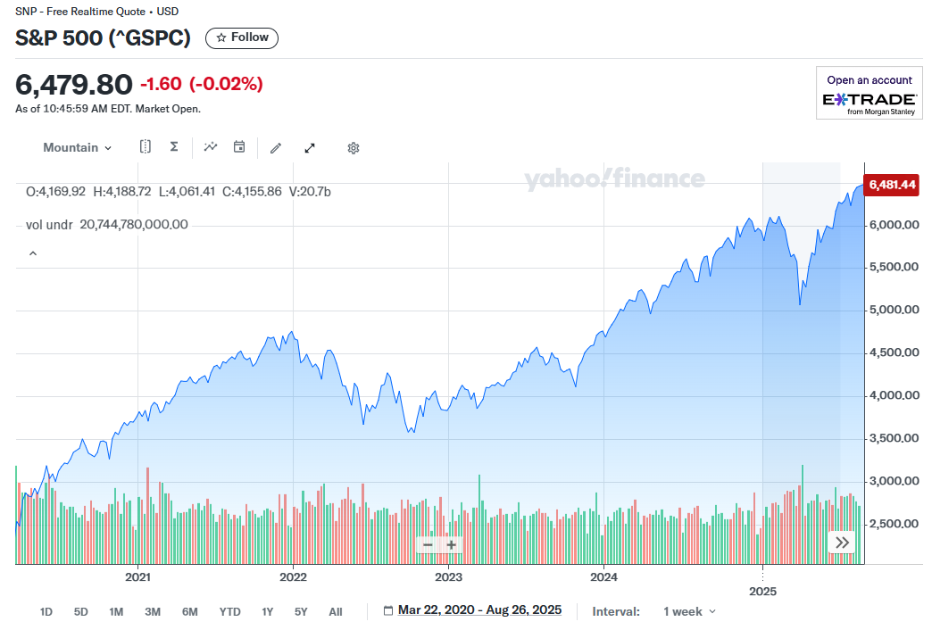
Website Recommendations – Yahoo Finance or Google Finance
Click here for the S&P500 Performance Calculator
Notes:
There has always been declines.

Slide 12
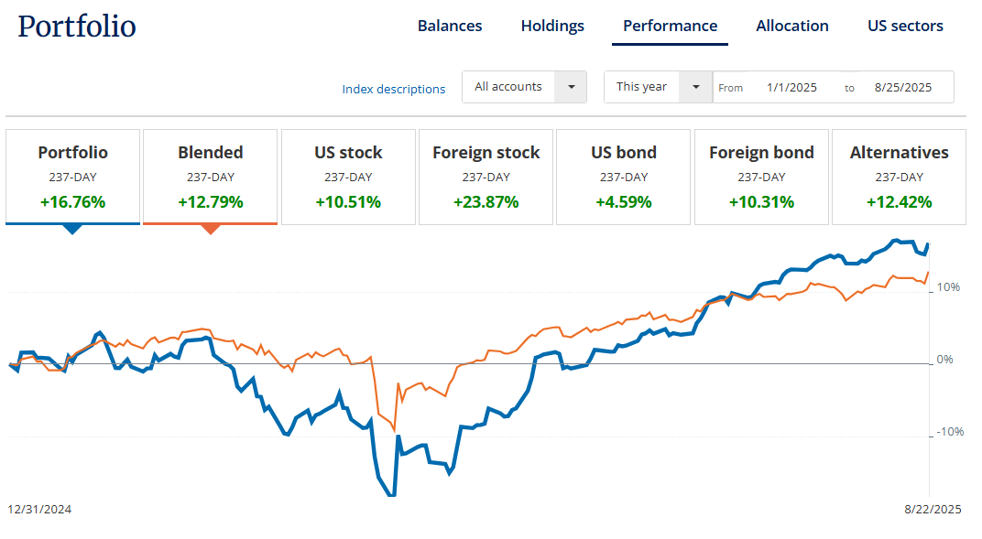
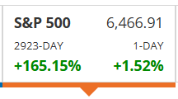
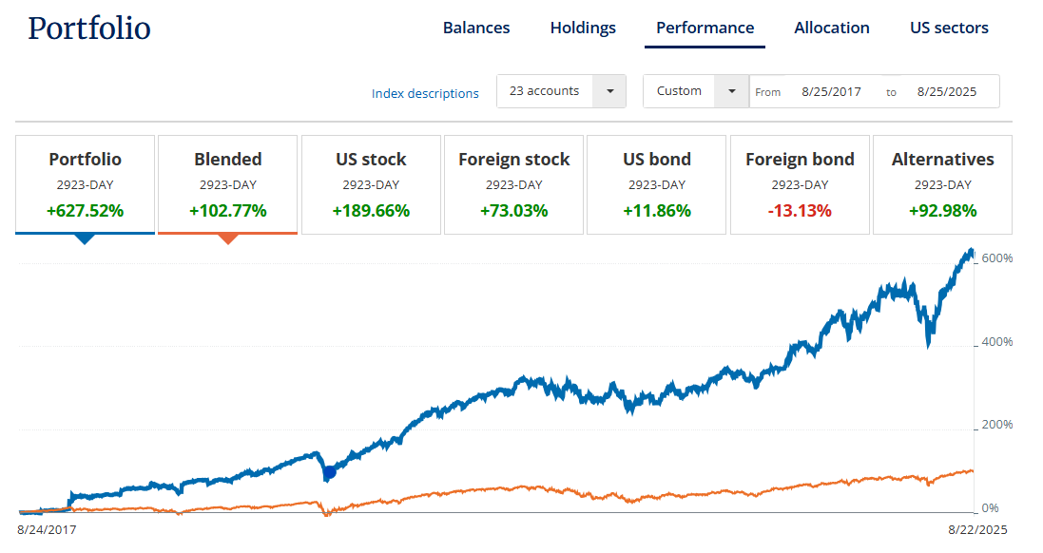
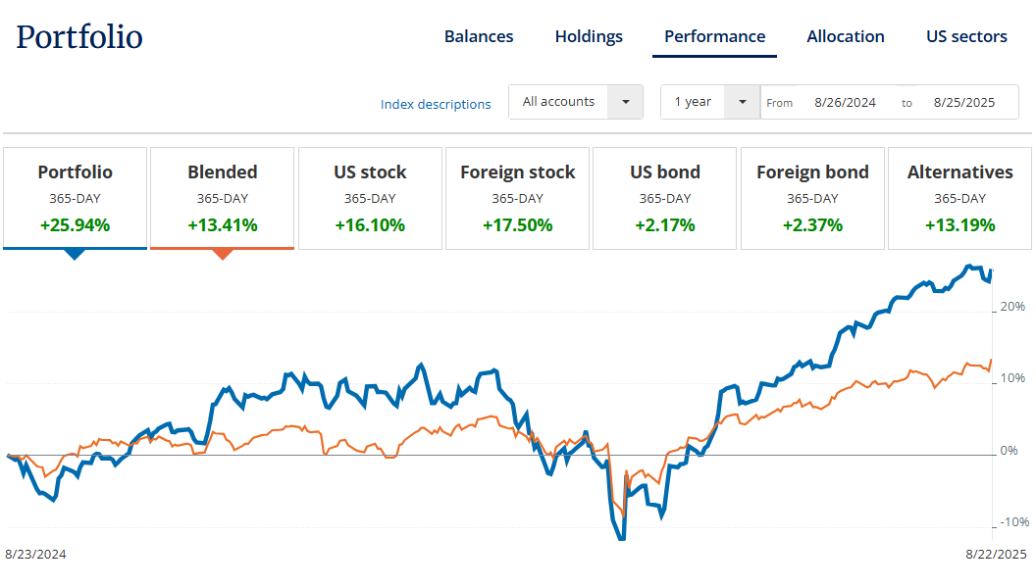
TNFG Portfolio Performance as of 8.22.25
YTD +16.76%
1-Yr +25.94%
8-Yr +627.52% or 78.44%
Notes:
There has always been declines. The Intelligent Investor.

Slide 13
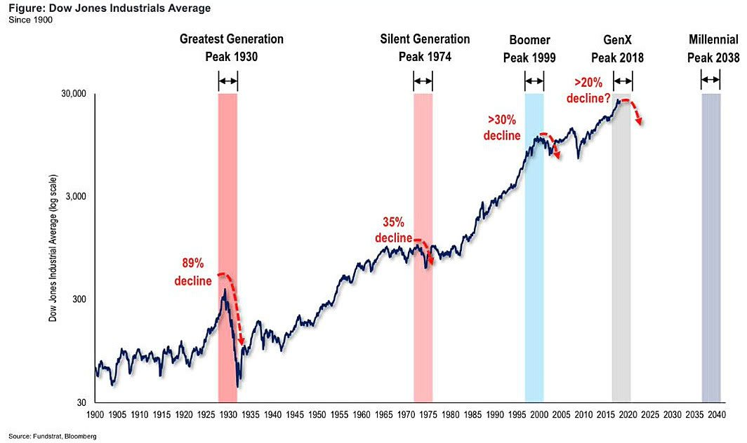
Is The Market Empty,
Is it Half Full or Half?
Notes:
There has always been declines. The Intelligent Investor.

Slide 14
The Questions?
Where do you start?
Do you even want to start?
What’s your goals?
What are you trying to accomplish?
Where do I balance in YOLO?
What about my wants?
What if I die?
I can start later…

Slide 15

I’m not Going to hold you but…
Hard Truths
If you don’t now your monthly/annual income and your monthly/annual expenses… Please stop now!
There are Levels!
  Beginner – I don’t know what the heck is happening with life. But I want to try. Take the Match ASAP.
  Mid - I’m confused so give me the super basic. Index and Chill.
  Wanna Be - I’m super smart and want to start gambling. I think I’m Warren Buffet v2025. I’m special… Quantitative Analysis and I’m ready to lose it all?
  F.I.R.E.D. Up? - I’m just trying to be Rich and Retire. Max to reduce Tax and Grow My Wealth.

Slide 16


The Investment Special Outline
There are levels to this!
The Mkt. Vocabulary
Building Blocks
The Investment Process from beginning to end
*Capital Gains Taxes, Tax Loss Harvesting, etc…
*How to build a portfolio
  Million Dollar Portfolio
*How to test that portfolio

Slide 17


The Mkt Vocabulary
Investment Terms
What’s Your Strategy?
Stock – ownership in a company
Bond – loan money to bond issuer (corporate or state/municipality)
Mutual Fund – A diversified portfolio of stocks &/or bonds (or other investments) vs. ETFs
Dividend – a portion of a company’s earnings paid to stockholders
Capital Gain (loss)–increase (decrease) in value of investment – occurs only when you actually sell
Rate of Return (or Yield) –total return on investment expressed as a % of price
BUY and #HODL anticipates long-term economic growth
Dollar-cost averaging buys at “below average” costs – Invest same amount every month – Set up automatic deposit.
Portfolio diversification
  Reduces volatility
Asset allocation
  % to desired investment categories – Rebalance yearly to desired %
    Rule of 120 i.e. 80% stocks/20% bonds
#BOOLEAN Search

Slide 18
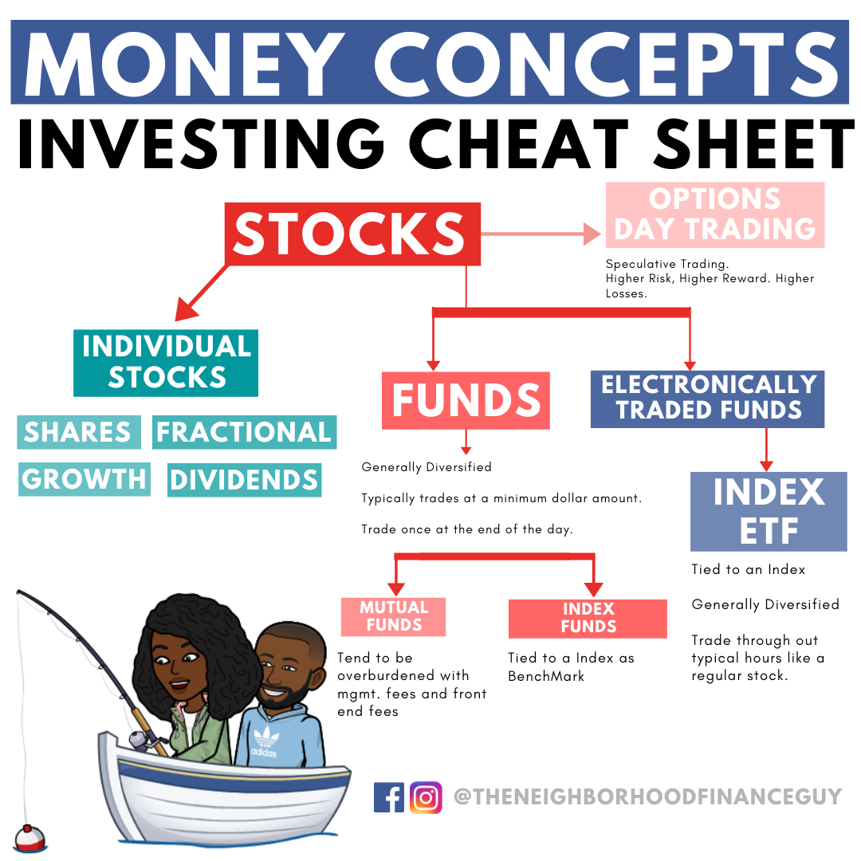

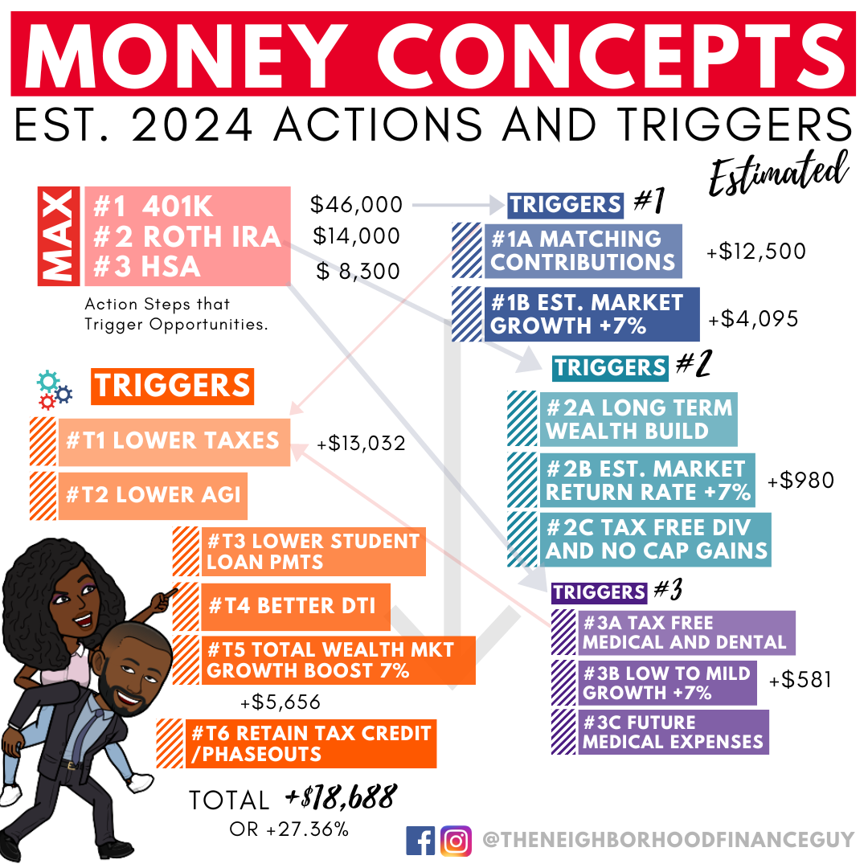
#FirstInvestments
Notes:
Dow. The Market. SP500. Winners and Losers. What can happen? Boomers will leave. Wealth transfer and wealth opportunity of over $68 trillion in assets. Generational Wealth or Generational debts.

Slide 19

Just Copying Me Won’t Work
That’s Not Investing Works
Majority of those gains are in the past. Investments stack upward. Let’s say you bought stock XYZ because you saw me talking about it in 2025 for $100 and it goes up to $110. That’s a 10% increase.
But I bought 20 shares at $50 in 2020 and 1 share at $100 in 2025. My 2020 shares would be up 120% and my one share is up 10%.

Slide 20
How We Work?
Knowledge and Action
My wife and I have one bank account. Dual income with no kids. Even though we aren’t in high income industries, we are in higher than the national average area (NE) (+30%). No daycare costs does help (diff. $9k per year). We own a 2/2 condo which reduces our housing cost by $24k per year.
Taxes are higher however we invest most of our funds on the front end into our 401ks! Our taxes are reduced by around $10k annually while our investments are funding in 90/10 portfolios i.e. mutual funds (+9% avg.). We review the expense ratio (<0.50% saving $300k) as well but that’s not a big determinant factor.
We max out ROTH IRAs at $7K due to traditional IRA income phase out limits for married (> $146k in 2025) and we invest into separate Health Savings Accounts at $4,150. She needs hers for Type1 expenses.

Slide 21
What Can Work?
Knowledge and Action
401ks to reduce taxes.
Matching contribution (even at $3k a year) is worth $400k with 30 years.
Considering HSAs and IRAs if you have the income.
Homeownership (start smaller)
No new cars and pointless leases.
Having a plan and not spending frivolously.
Investing on the front end and working with what’s left.

Slide 22
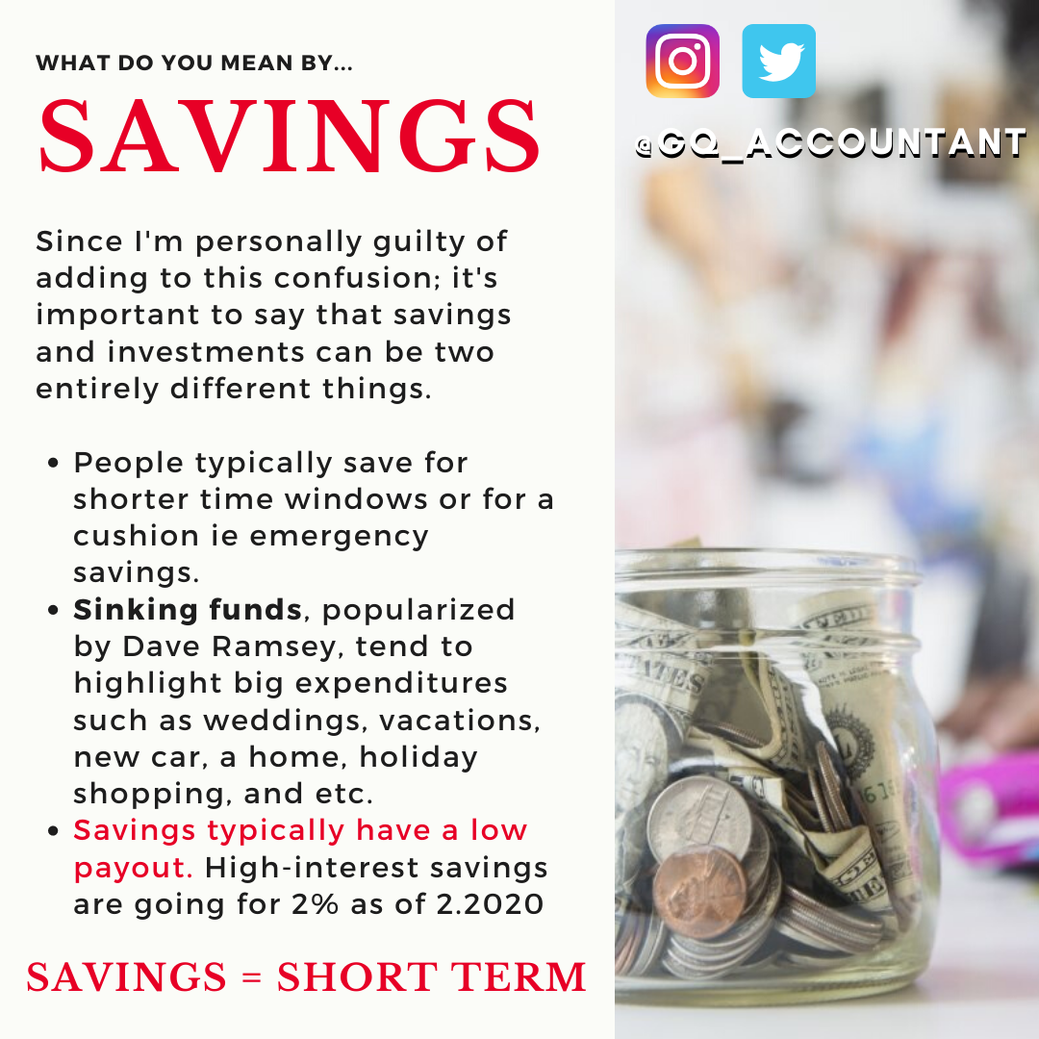
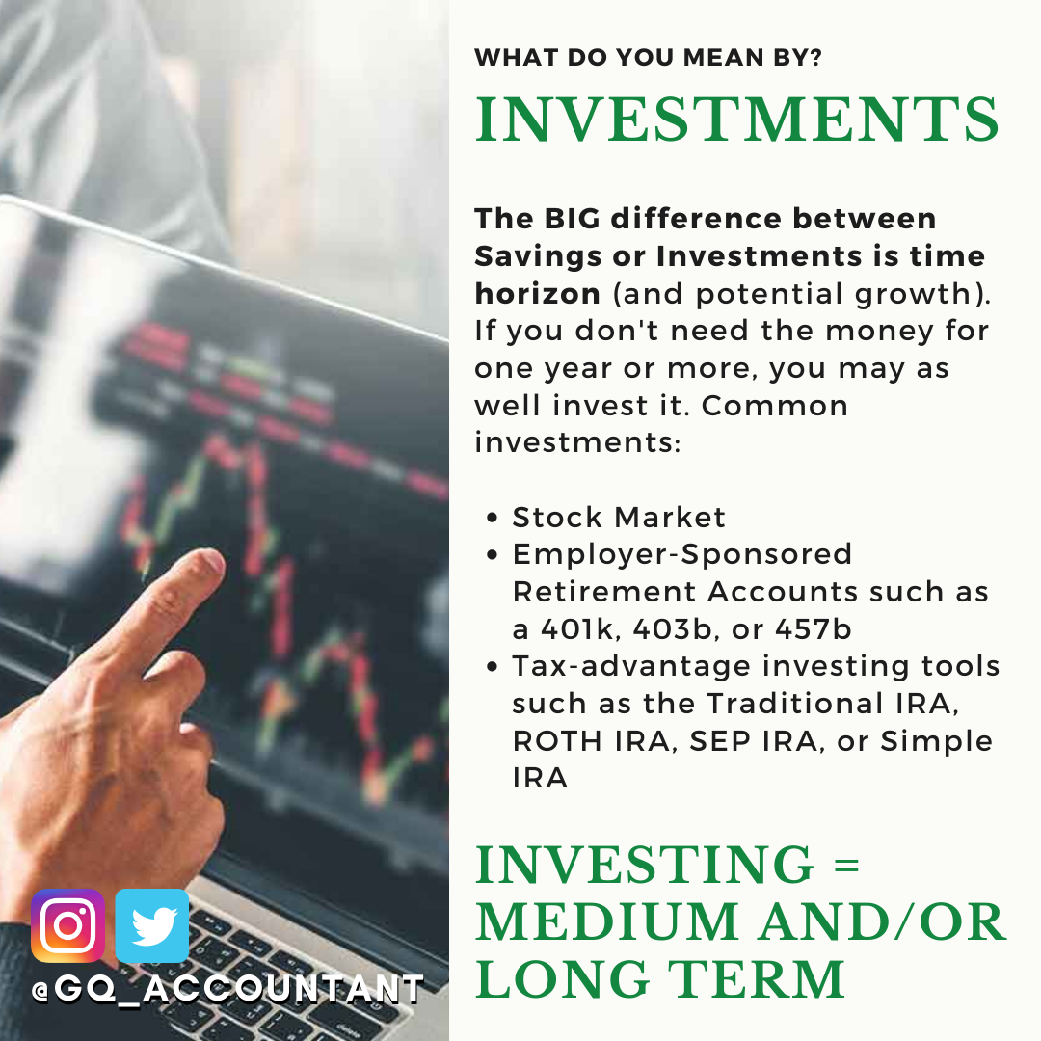
#Saving vs Investing Analysis
vs
Notes:
Savings vs Investing Analysis

Slide 23

Example #1
Putting 2025 into Perspective
www.google.com
www.Bankrate.com
https://www.calculator.net/investment-calculator.html
TVM Calculator

Slide 24
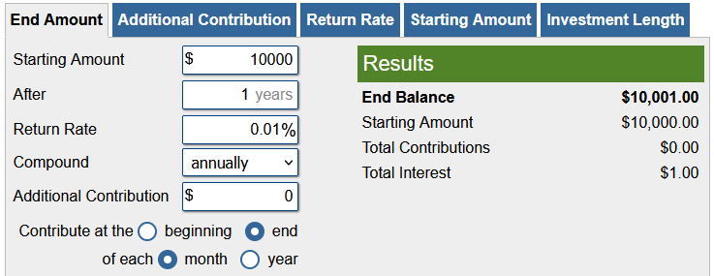


Results #1A
You Can’t Save Yourself into Wealth
Saving at 0.01%
Investing at 27.70%

Slide 25
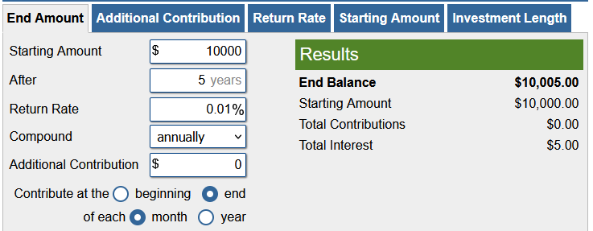

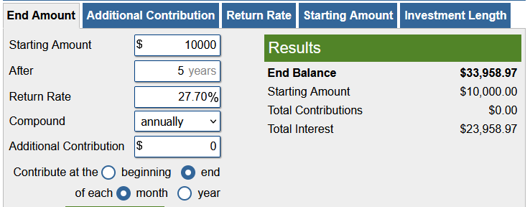
Results #1B
You Really Can’t Save Yourself into Wealth
Saving at 0.01%
Investing at 27.70%

Slide 26
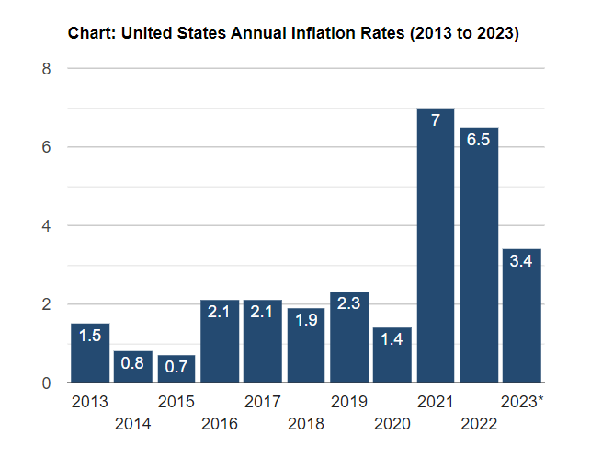
Results #1C
With Inflation
Saving at 0.01% from January - December 202X
Eroding Real Purchasing Value
Notes:
Current Inflation is

Slide 27
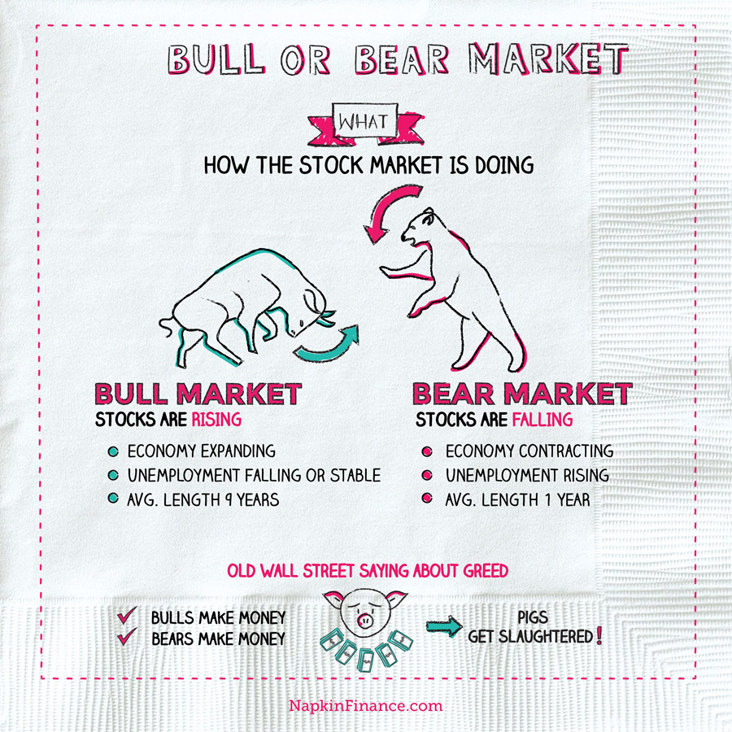
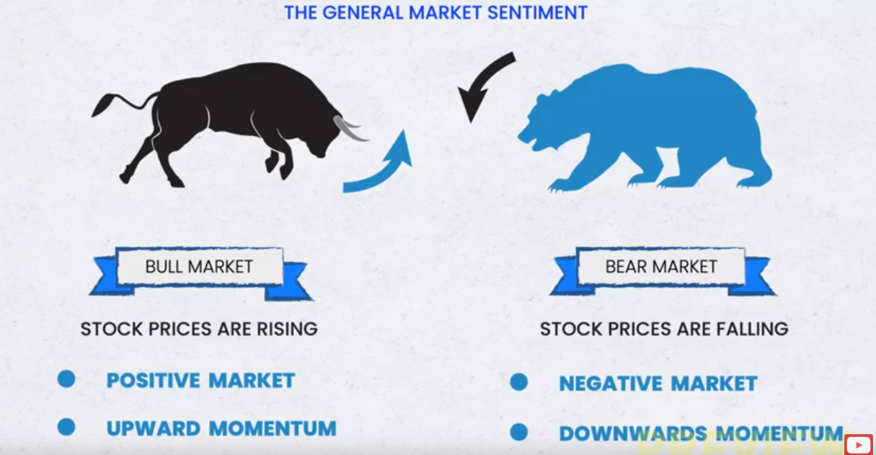

#Cycle Analysis
Bulls vs Bears?
Boomers vs Millennials?
Inflation! Recession?
Notes:
Dow. The Market. SP500. Winners and Losers. What can happen? Boomers will leave. Wealth transfer and wealth opportunity of over $68 trillion in assets. Generational Wealth or Generational debts.

Slide 28
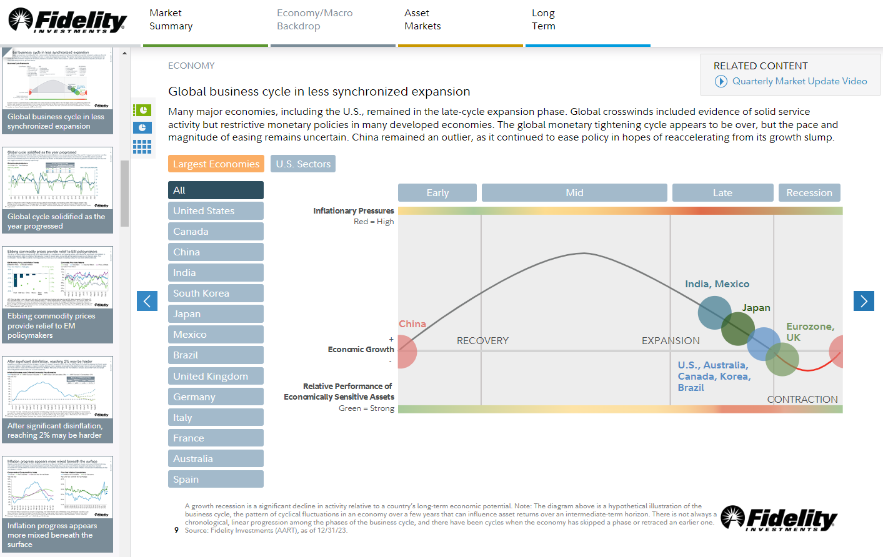

#Cycle Analysis
Notes:
Dow. The Market. SP500. Winners and Losers. What can happen? Boomers will leave. Wealth transfer and wealth opportunity of over $68 trillion in assets. Generational Wealth or Generational debts.

Slide 29
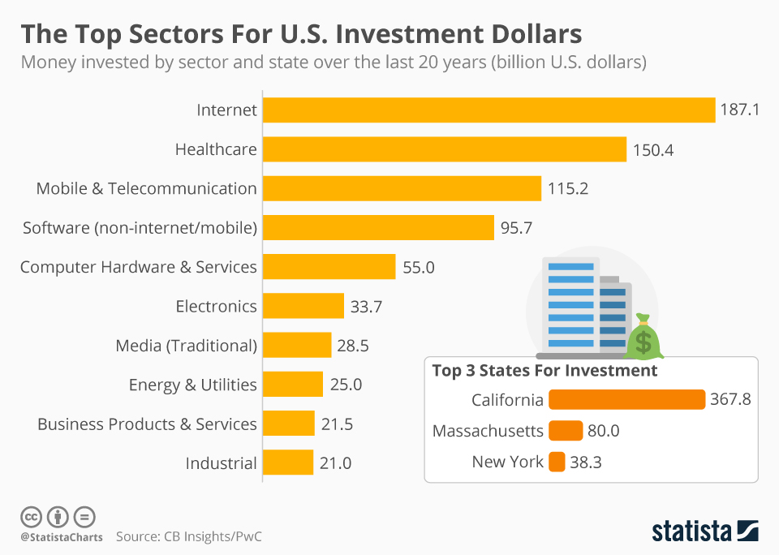
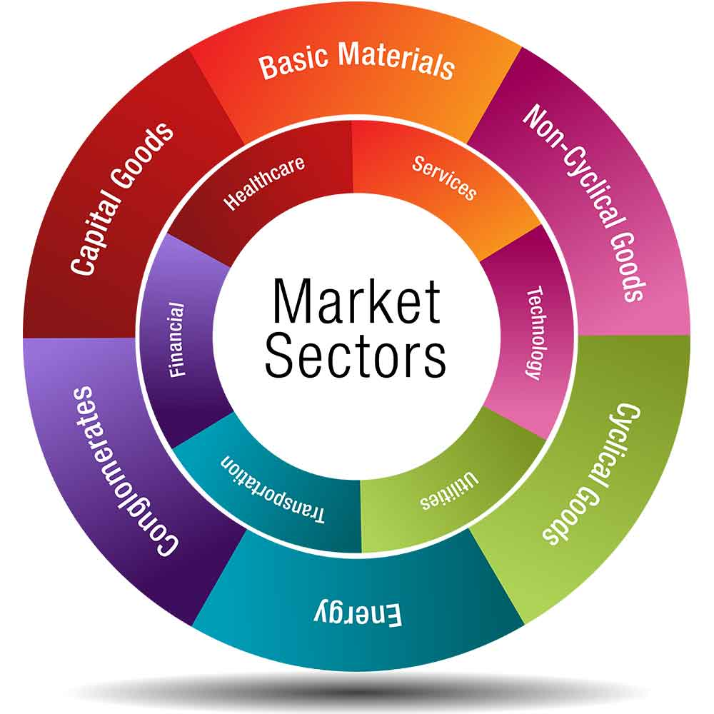
#Sector Analysis
Tech and More Tech
Notes:
Dow. The Market. SP500. Winners and Losers. What can happen? Boomers will leave. Wealth transfer and wealth opportunity of over $68 trillion in assets. Generational Wealth or Generational debts.

Slide 30
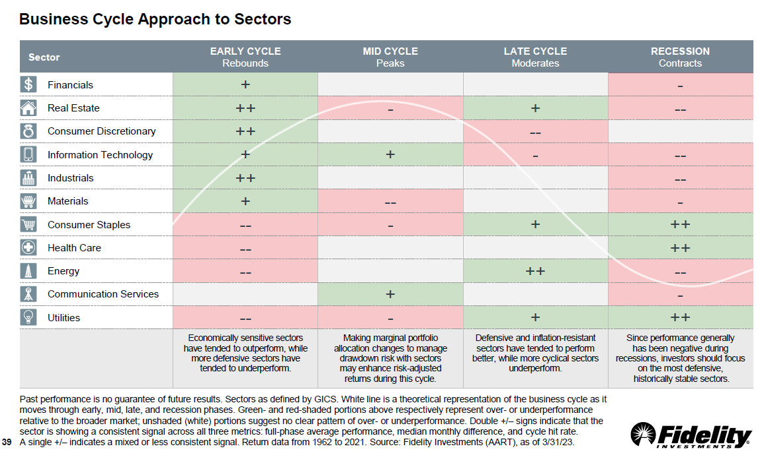

#Sector Analysis
Notes:
Dow. The Market. SP500. Winners and Losers. What can happen? Boomers will leave. Wealth transfer and wealth opportunity of over $68 trillion in assets. Generational Wealth or Generational debts.

Slide 31
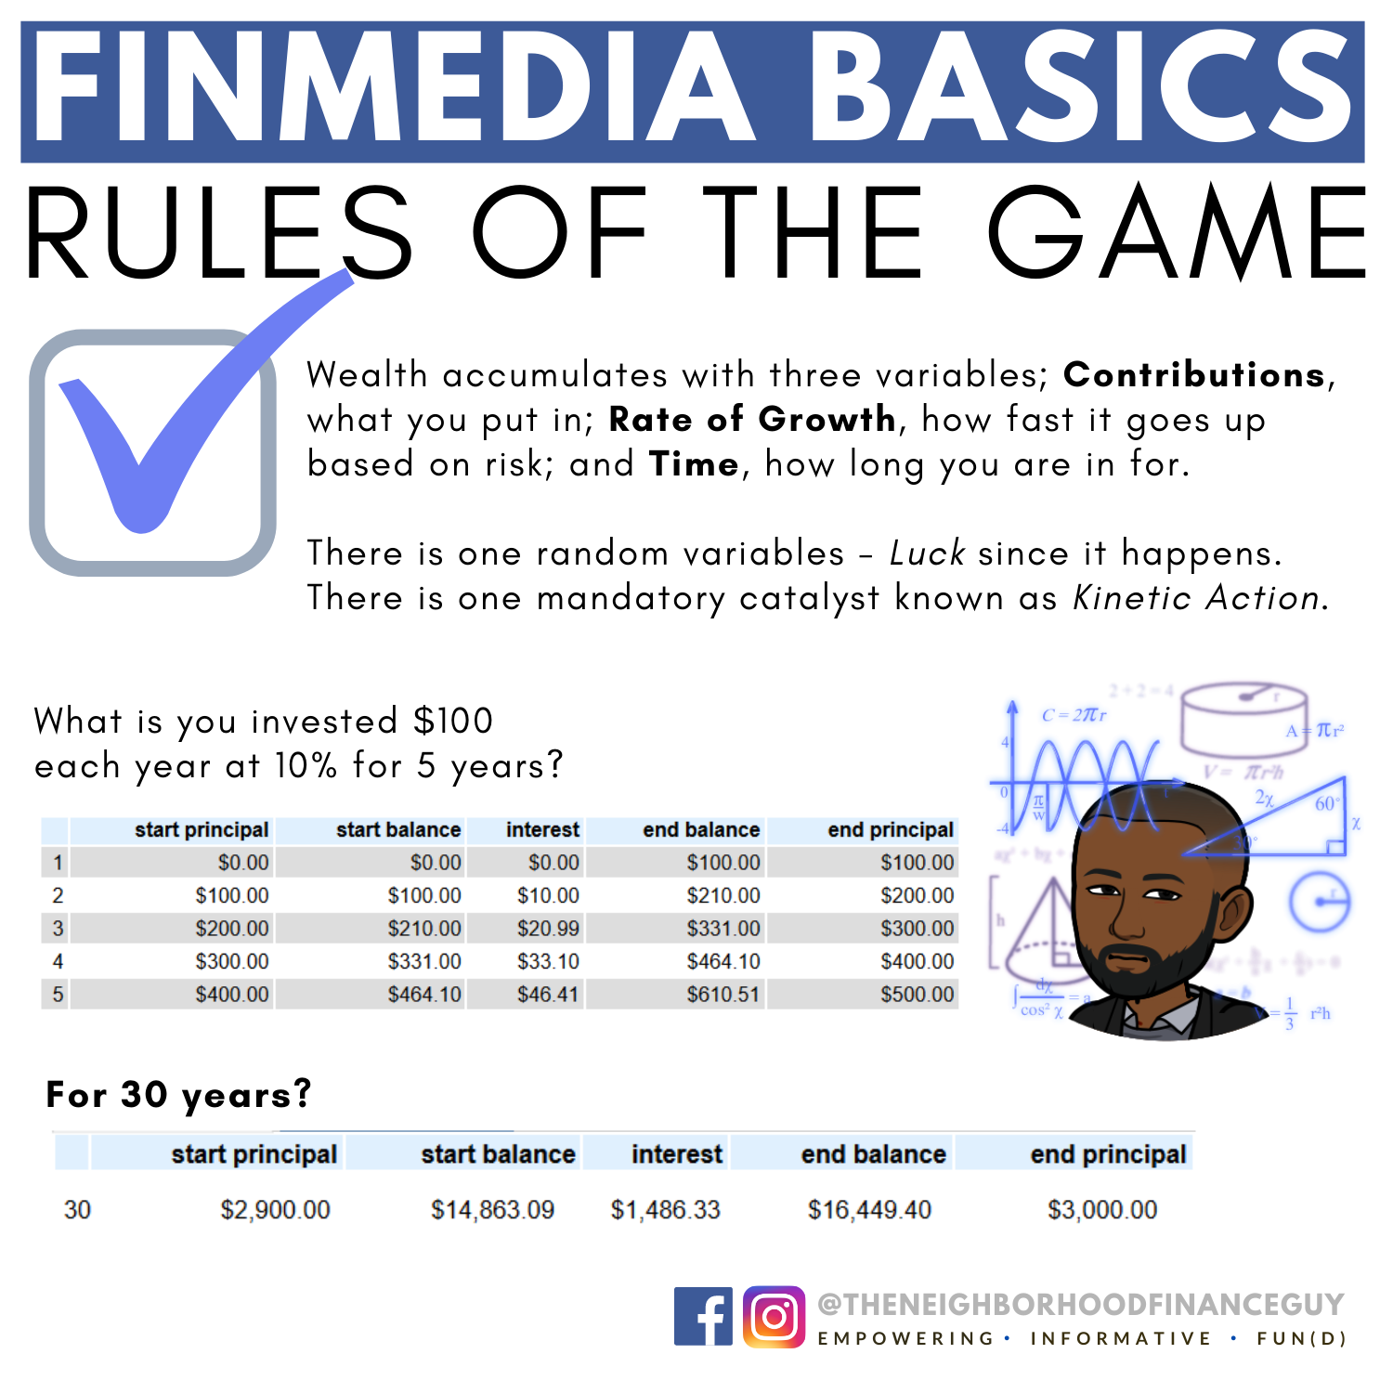
Wealth through “Invited Luck”
Wealth $$$ =
[{Contributions x (1+ Rate) } – Inflation – Anticipated Taxes] ^{Time}
1
Track your spending, savings, and investments
Pay yourself first
Start a side hustle
Find a residual income stream
2
Wealth = [Contributions x (1+ Rate)] ^{Time}
3
Wealth = Effort x Rate x Time
Notes:
Real portfolio. It will continue to grow and gain exponential momentum toward the future.
Pure Luck vs Invited Luck - “luck is not something to be found just anywhere. Rather, it is something that descends only upon those standing where it will drop.”

Slide 32
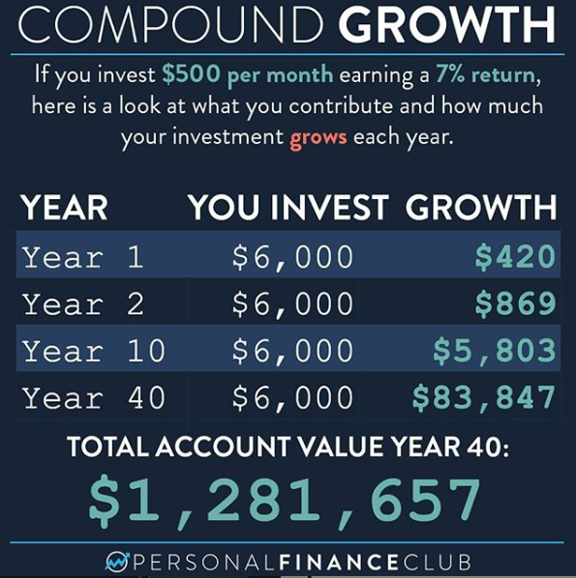
#Investing
Making Money, Make Cents
Investing is the third step on the road to financial success. *Not the first step!
Why do People want to Invest? To achieve financial goals; 1. Retirement savings, 2. Financial security, 3. Lifestyle changes, 4. It’s the adult thing to do.
So, What’s your timeline?
Why do you want to invest?
Cntrl + ALT + Accept

Slide 33
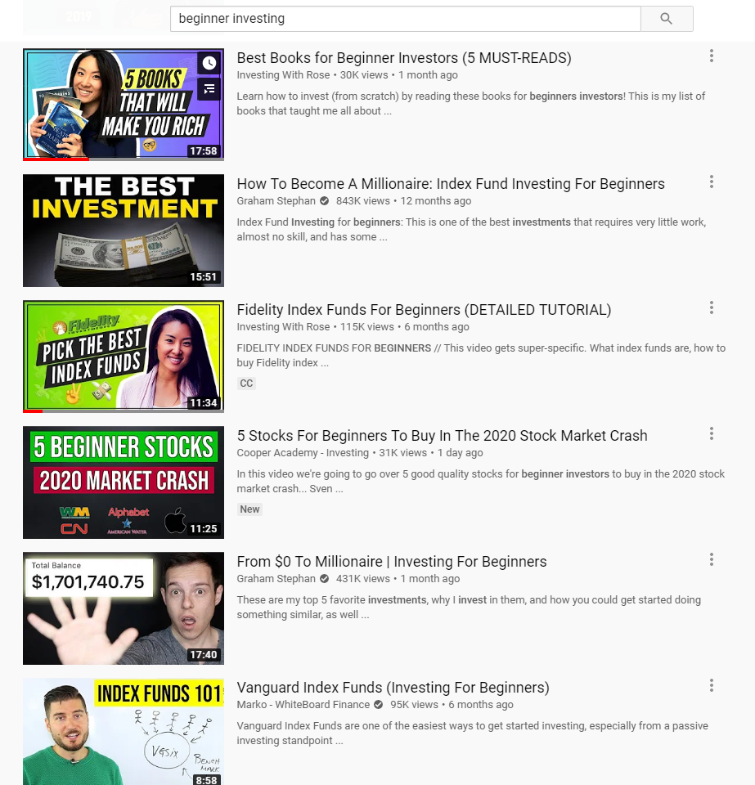
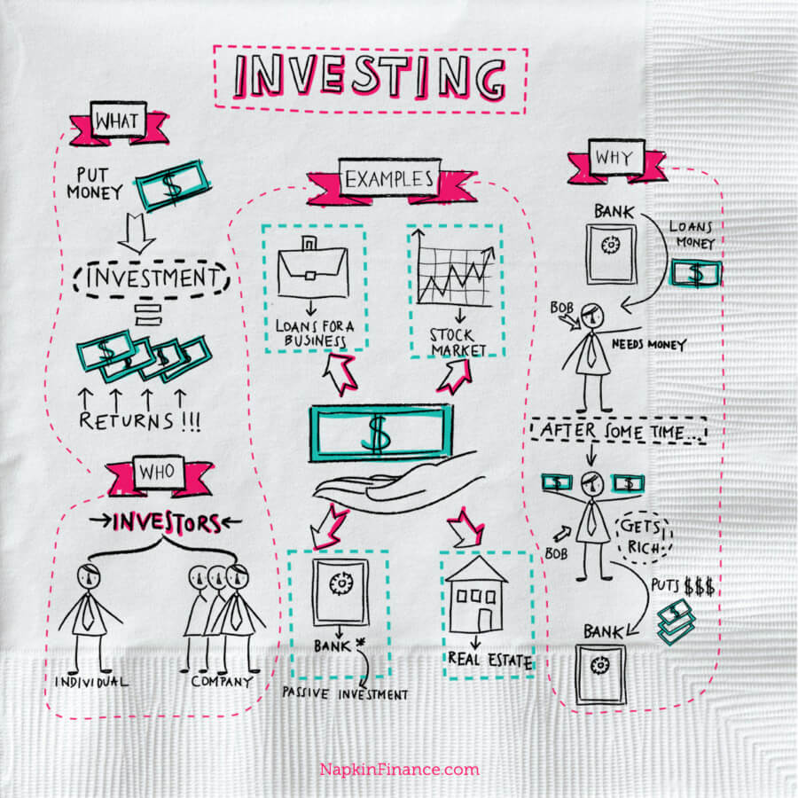
Discernment of Information
YouTube Recommend – Investing With Rose!
Notes:
Investing with Rose
PPCian
Joseph Carlson, Etc…

Slide 34
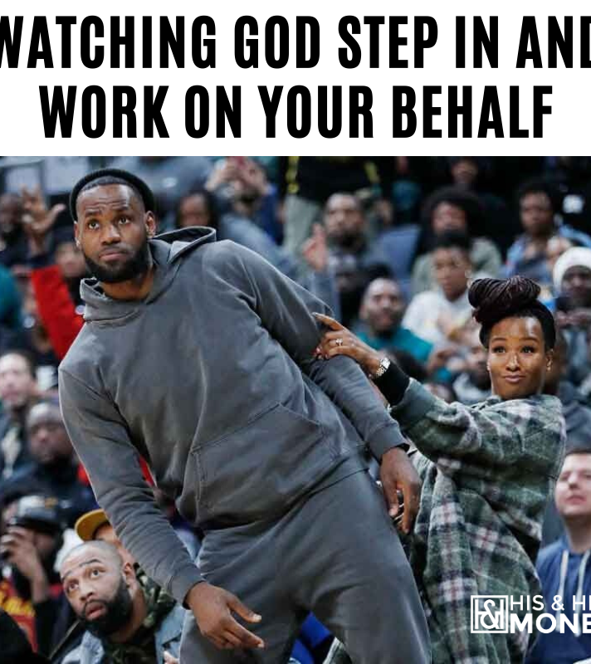
#InvtProcess
Not a Destination, Nor a Shortcut
Set Aside the Money. Consider no less than $250/monthly or a fixed cash amount yearly.
Pick a Brokerage.
  Fidelity, Schwab, Merrill Lynch, Robin Hood, Acorn, Betterment, M1 Finance, Vanguard, etc…
  It comes down to which platform makes sense to you the most.
Is it reoccurring deposits or fixed when you can?
Is your portfolio adjusted manually or automatically, or based on your risk profile?
  This determines how balanced you are and/or how aggressive you want to be.
Buy, Hold, Sell and Get Taxed
Notes:
Even $100 per week at 9% for 40 years, it’s

Slide 35
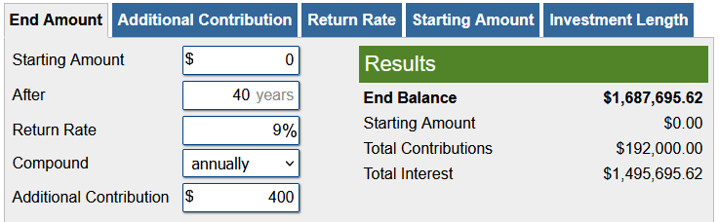
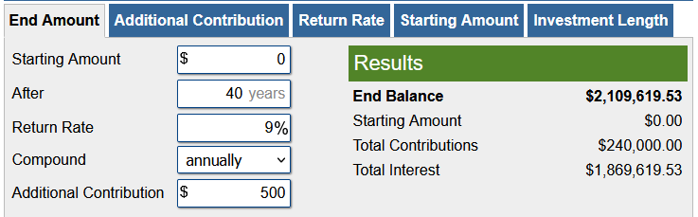
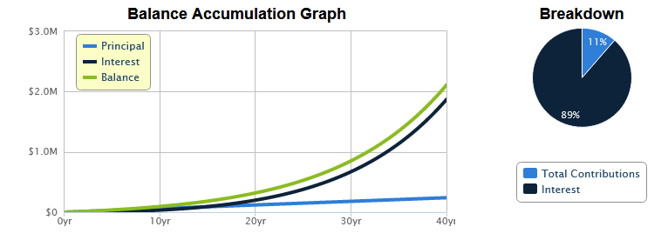
#InvtProcess
Investing $100 per week
Investing $500 per month
Notes:
Even $100 per week at 9% for 40 years, it’s

Slide 36


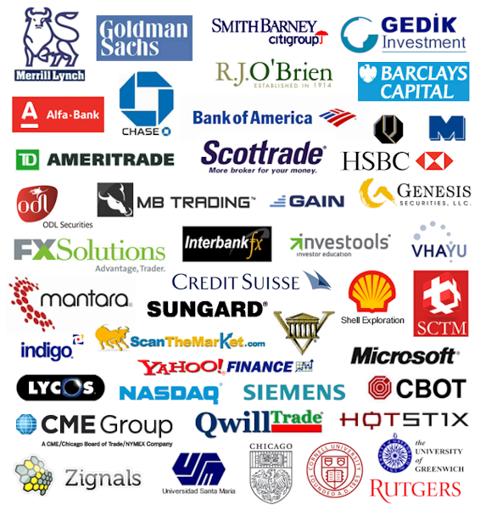
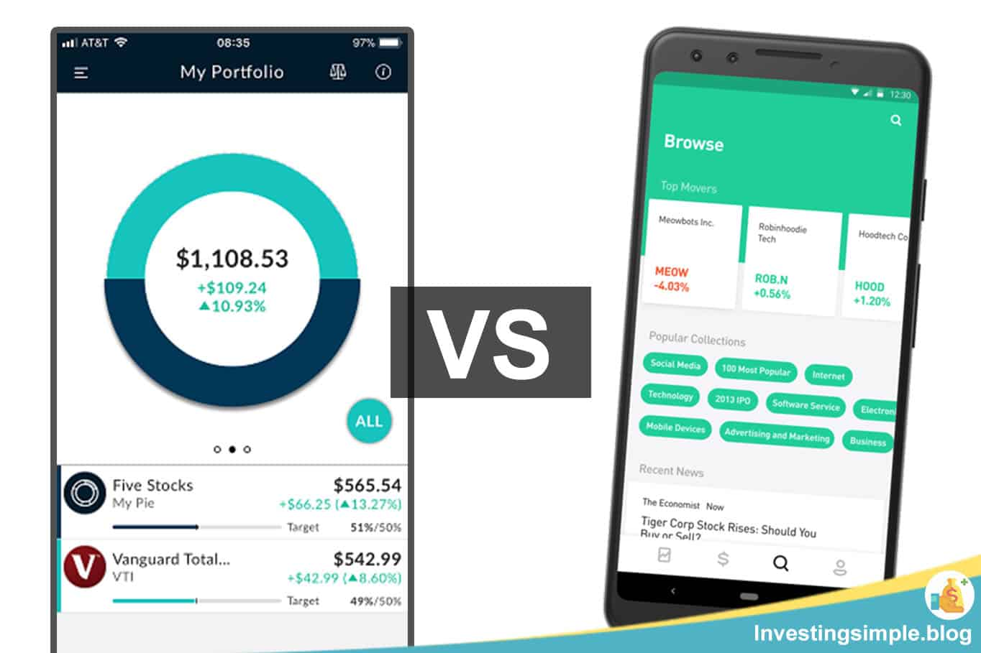

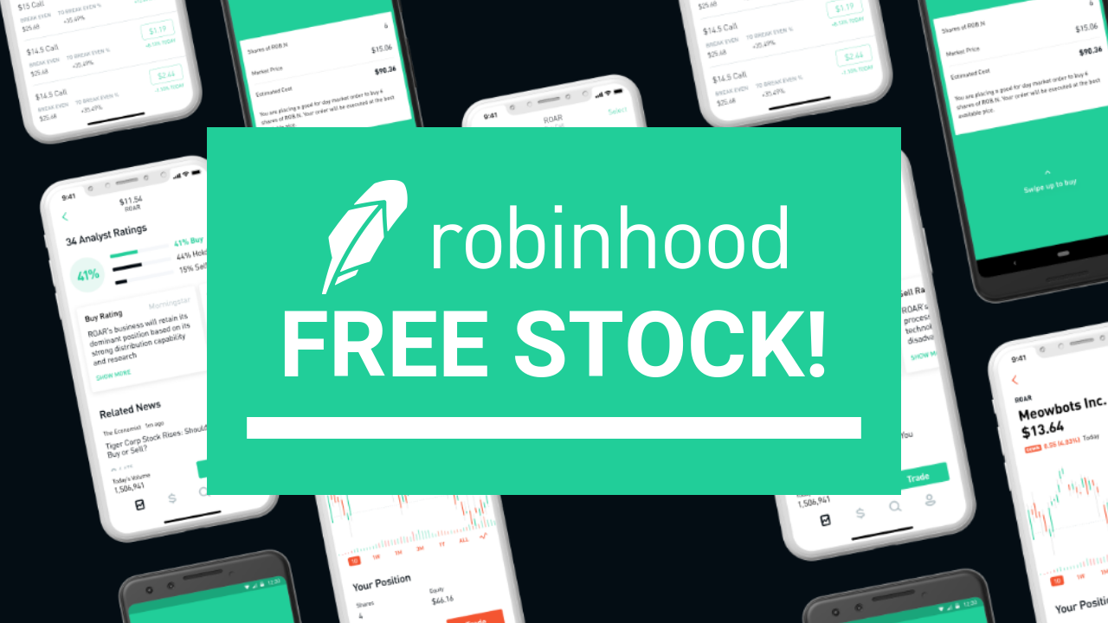
Breaking Down the Brokerage
It Depends On Your Style and the Fees.
Notes:
All of this will be hot topics for the next season of the Financial Griot.

Slide 37
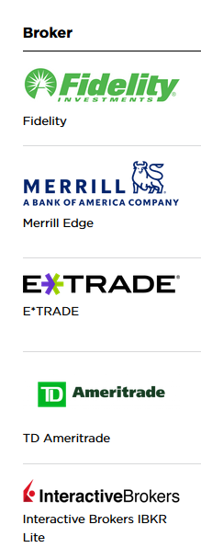
Brokers or Brokerages?
Top 5 Ranked
In the Simplest Term
A brokerage company’s main duty is to act as a middleman that connects buyers and sellers to facilitate a transaction.
Brokerage companies typically receive compensation by means of commissions or fees that are charged once the transaction has successfully completed. Nowadays these might be paid by the exchange or by the customer, or in some cases both. Because many discount brokerages have instituted zero-commission trading, they make up for this loss of revenue in other areas, including getting paid by the exchanges for larger quantities of order flow. For example, when a trade order for a stock is executed, an investor pays a transaction fee for the brokerage company's efforts to complete the trade.
Notes:
The grocery store

Slide 38
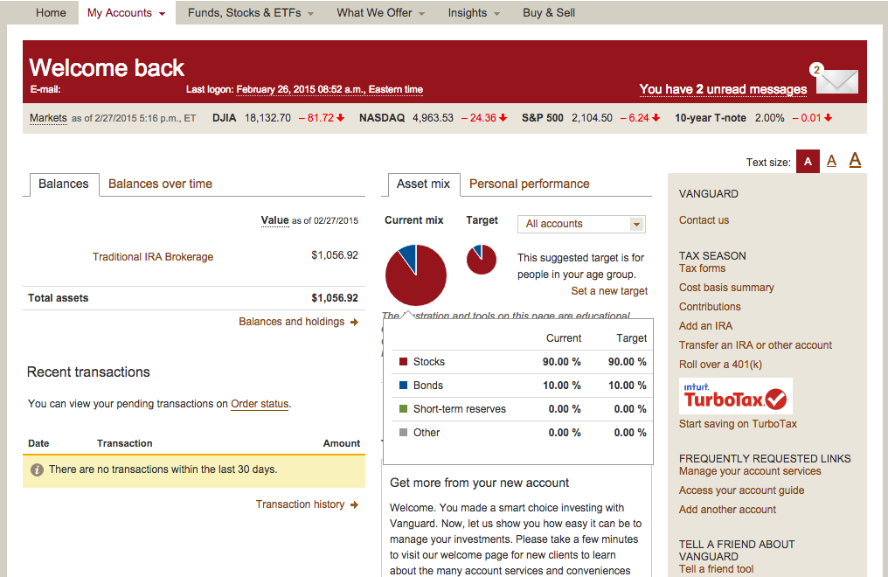
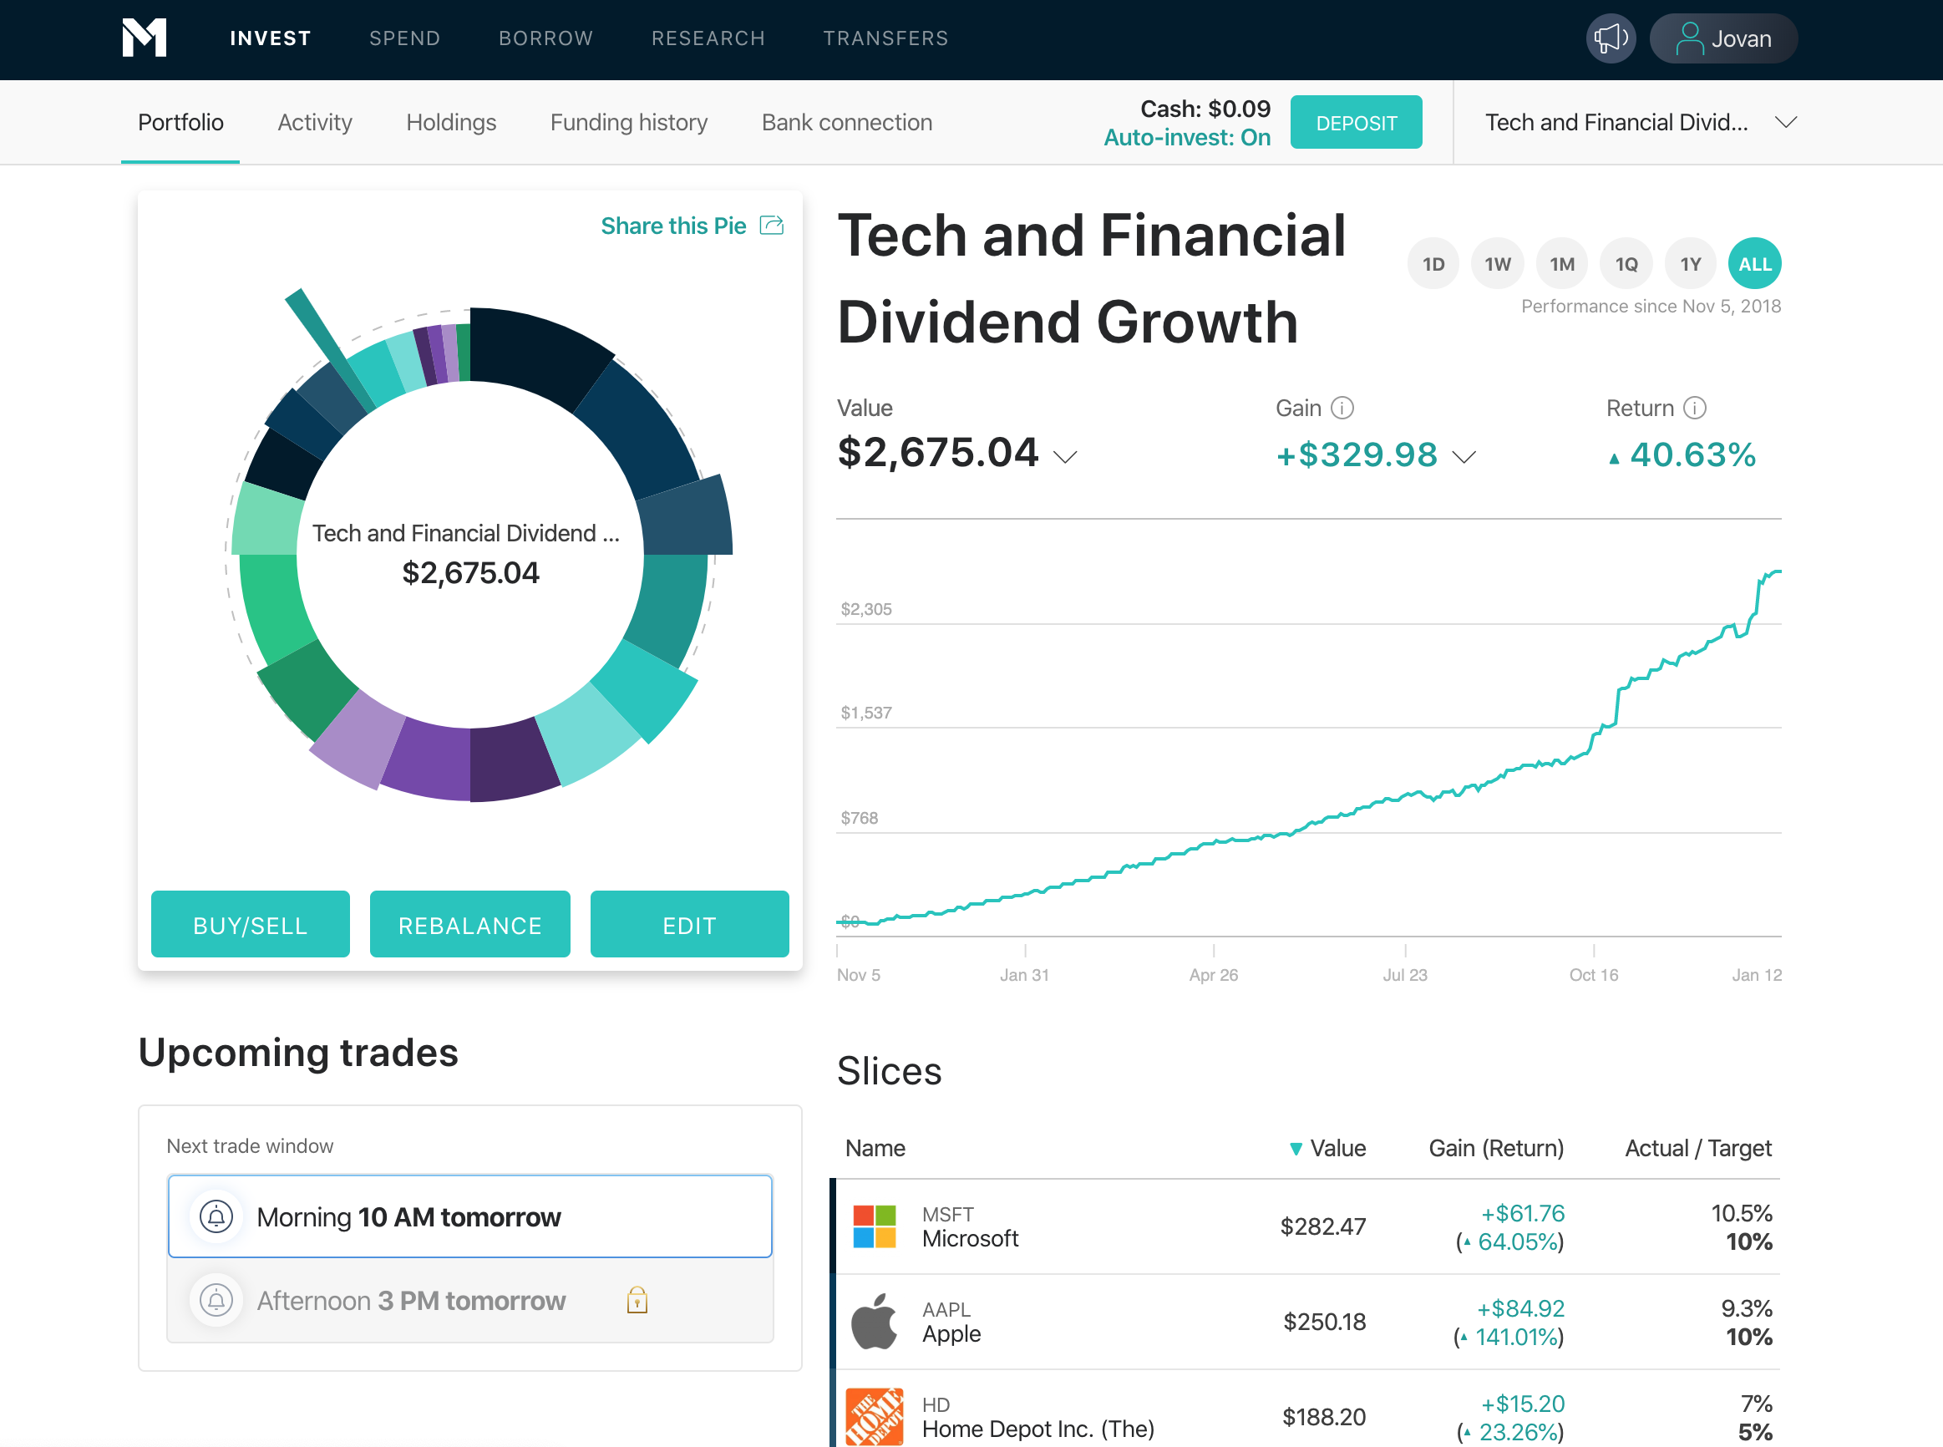
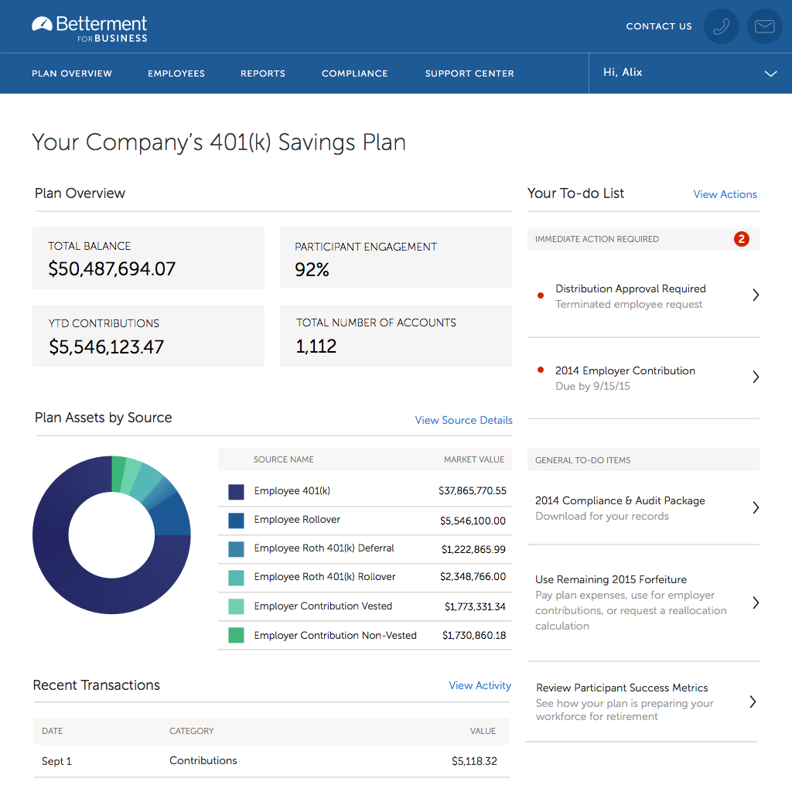
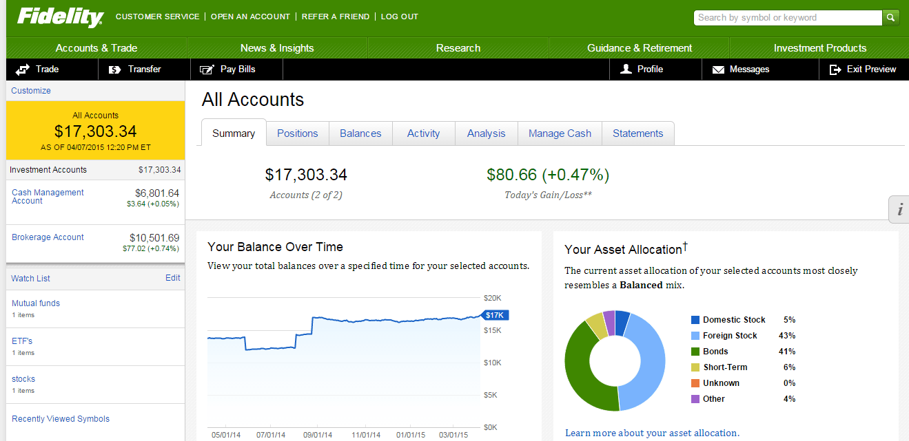
Layout Examples
Vanguard.com
M1Finance.com
$10 Referral Code
Betterment
Fidelity.com

Slide 39
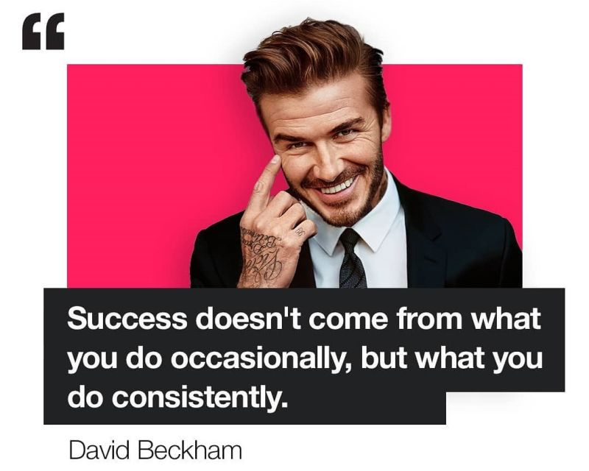
Example #2
Variety and Style
M1 Finance - $10 Opportunity
Merrill Lynch
Fidelity - $100 Starter Pack
TD Ameritrade – Think or Swim

Slide 40


Successful Investing

Slide 41





Levels to Owning Shares
Experts prefer Indexes over Mutual Funds due to Fees
Some Investments Pay Out Dividends
You Can Own Shares of specific companies and indexes at the same time.
You can buy individual stocks
You can buy Indexes or Mutual funds, i.e. Total Mkt Funds which are made up of various stocks
Your Purchases Represent Your Portfolio
Some Indices are Sector Based

Slide 42

#Building a Winning Portfolio
Time to Craft
Know your Risk Profile and Capacity. Risk vs Reward
Set your terms and Plans. Growth vs Income. Managed or auto pilot.
Strategy and Going Concern.
  Buying and Sell Out
  Rebalancing or Tax Loss Harvesting ($3,000)
Review And Mastery
  Graham Fair Value
  Fundamentals

Slide 43

Generation Money Management
Determine Your Risk Tolerance
Determine Your Risk Capacity
How much risk can you stand?
Risk tolerance quiz: – http://njaes.rutgers.edu/money/riskquiz/
Lots of online quizzes
What is your time horizon to achieve your investment goal?
  More risk with long-term goals
  Less risk with short-term goals
Risk capacity, unlike tolerance, is the amount of risk that the investor "must" take in order to reach their financial goals.
The rate of return necessary to reach these goals can be estimated by examining time frames and income requirements. Then, the rate of return information can be used to help the investor decide upon the types of investments to engage in and the level of risk to take on.

Slide 44



#Distribution
Stocks as a Pie
*Aggressive
90/10
*Defensive

Slide 45


#Capital Gains Tax
Either Ordinary or Reduced
Notes:
For example, in 2023, individual filers won’t pay any capital gains tax if their total taxable income is $44,625 or below. However, they’ll pay 15 percent on capital gains if their income is $44,626 to $492,300. Above that income level, the rate jumps to 20 percent.
For the 2024 tax year, individual filers won’t pay any capital gains tax if their total taxable income is $47,025 or less. The rate jumps to 15 percent on capital gains, if their income is $47,026 to $518,900. Above that income level the rate climbs to 20 percent.
In addition, those capital gains may be subject to the net investment income tax (NIIT), an additional levy of 3.8 percent if the taxpayer’s income is above certain amounts. The income thresholds depend on the filer’s status (individual, married filing jointly, etc.) and are not adjusted for inflation.

Slide 46

#TNFG Game Plan
Deep Cuts
90/10 Strategy.
  Way more Stocks than Bonds
60% Growth to 40% Dividends.
  Starting line up, but shift with Different Seasons
Buy or Sell (Entry and Exit Strategy)
  Sell over 40% mkt value. Buy if mkt drops 30%
  Dollar Cost Average
Beware of Taxes

Slide 47


#TFG Game Plan

Slide 48

Bonus
Don’t Just Follow; make an active choice.
www.etf.com
www.portfoliovisualizer.com
www.dividendwatch.com
www.thinkorswim.com

Slide 49


Results #4
$25/Day
Think of it as Daily Investments
$16.67/Day

Slide 50

Example #5
Create our own

Slide 51



For One Year!
What’s a Million Dollar Portfolio look like for 2021-2025?

Slide 52


Set Your Own Retirement
Notes:
Biggest Concerns after Savings:
1. Healthcare costs. According to Goldman Sachs, 44% of retirees indicated they had concerns about future healthcare needs.
2. A possible Social Security benefits reduction. Worries about Social Security came in a close second to concern about retirement costs.
3. The consequences of inflation.

Slide 53
The Retirement Formula
3-Part – SS Benefits + 401k + other Savings (i.e. Pension)
 | 20s-40s | 40s-50s | 55+
Ratio of $100k | 100% | 75% | 50%
Retirement Need Multiply by 25 or 4% withdrawal rate | $2.5M | $1.875M | $1.25M
Safety Margin Need Minus $25k Social security | $1.5M | $968,750 | $437,500
How to get there? Years, Interest Rate, Contribution per year and by month | 30yrs, 9%, $12,000 Basically $1,000 per month | 20yrs, 8%, $21,000 $1,750 per month | 10yrs, 7%, $30,000 ~$2,500 per month
Noted Links: Inflation Calculator and Financial Independence Retire Early (FIRE) calculator
Notes:
By 2042
Lower Working Class -> 45k - $90k
Middle Working Class -> 60k - $120k
Upper Middle -> 75k - $150k
True Upper -> 100k - $200k

Slide 54



#Close Out
That’s a lot, Recap
The Investment Process from beginning to end
How to build a portfolio!
Highly recommend you tune into the Financial Griot Podcast!
Follow TFG team on social media!
And Get your $10 Referral!

Slide 55

Website Recommendations
Essentials: Mint.com, Personal Capital (now Empower) and SSA.gov
Savings, Mortgage rates and credit card rates - www.Bankrate.com
Debt Snowball Calculator
Google Finance and Yahoo Finance
Investment Back testing (advanced) - www.portfoliovisualizer.com
Exchange Traded Funds (ETF) – www.etf.com
Brokerages include Fidelity, Vanguard, M1 Finance, Robinhood, Schwab, etc…
Net/Max Financial Plans to build wealth in less than 15 years
  Other resources: Budgeting, Personal Taxes, etc.

Slide 56


Book Recommendations
Atomic Habits: An Easy and Proven Way to Build Good Habits – James Clear
The Automatic Millionaire: A Power One Step Plan – David Bach
Your Money or Your Life – Vicky Robins
The Psychology of Money – Morgan Housel
The 12 Week Year – Brian P. Moran
Can’t Hurt Me and/or Never Finished – David Goggins
Grit: The Power of Passion… – Angela Duckworth
Monsters and How to Tame them – Kevin Hart
The One Thing – Garry W. Keller
Born a Crime – Trevor Noah

Slide 57



Recap and Questions

Slide 58




F.I.R.E.# +$5M
Our Goal?!
Work hard,
Watch anime, stay healthy,
Invest as much as needed,
Retire early, create happiness,
Travel the world (50 by 50),
Help others along the way…

Slide 59




THANK YOU
+ Q&A time
Lawrence Gonzalez
@theNeighborhoodFinanceguy
theneighborhoodfinanceguy@gmail.com
www.theneighborhoodfinanceguy.com

